Slide 1
Data Encryption Standard
Example

Slide 2
let M be a plaintext message M = SUCCESS.
with a key of : DISCIPLINE.
        DES key Generation
                step1: start with key
                Each English letter = 1 byte = 8 bits.
                so the word DISCIPLINE have a 10 letters we use first 8 characters
                then key became a DISCIPLI.
                step 2:Convert each character to ASCII and then binary (8 bits each).
character | ASCII(dec) | ASCII(hex) | Binary
D | 68 | 44 | 01000100
I | 73 | 49 | 01001001
S | 83 | 53 | 01010011
C | 67 | 43 | 01000011
I | 73 | 49 | 01001001
P | 80 | 50 | 01010000
L | 76 | 4C | 01001100
I | 73 | 49 | 01001001

Slide 3
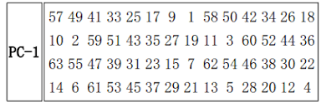
Round 1 of Key generation
a.start with 64-bits of key
64 bit key : 01000100 01001001 01010011 01000011 01001001 01010000 01001100 01001001
b.Drop parity bits → Permuted Choice 1 (PC-1).
So positions 8, 16, 24, 32, 40, 48, 56, 64 are removed.
64 bit key : 01000100 01001001 01010011 01000011 01001001 01010000 01001100 01001001
We permute the 56-bit key using PC-1 table.
0000000011111111000000000010 0000110001000001110100100100
c. split 56 bit into left(C0) and right (D0).
first left 28 bits C0 : 0000000011111111000000000010
right 28 bits D0: 0000110001000001110100100100

Slide 4
d. left Circular shift
1 bit in rounds 1, 2, 9, and 16
2 bits in all other rounds
for both C0 and D0
C0 :0000000011111111000000000010
left Circular shift of C0 = C1 = 0000000111111110000000000100
left Circular shift of C1 = C2 = 0000001111111100000000001000
left Circular shift of C2 = C3 = 0000111111110000000000100000
D0 : 0000110001000001110100100100
left Circular shift of D0 = D1 = 0001100010000011101001001000
left Circular shift of D1 = D2 = 0011000100000111010010010000
left Circular shift of D2 = D3 = 1100010000011101001001000000

Slide 5
step 5 : use left shift and generating 16 round subkeys.
Rounds(n) | Cn | Dn
1 | 0000000111111110000000000100 | 0001100010000011101001001000
2 | 0000001111111100000000001000 | 0011000100000111010010010000
3 | 0000111111110000000000100000 | 1100010000011101001001000000
4 | 0011111111000000000010000000 | 0001000001110100100100000011
5 | 1111111100000000001000000000 | 0100000111010010010000001100
6 | 1111110000000000100000000011 | 0000011101001001000000110001
7 | 1111000000000010000000001111 | 0001110100100100000011000100
8 | 1100000000001000000000111111 | 0111010010010000001100010000
9 | 1000000000010000000001111111 | 1110100100100000011000100000
10 | 0000000001000000000111111110 | 1010010010000001100010000011
11 | 0000000100000000011111111000 | 1001001000000110001000001110
12 | 0000010000000001111111100000 | 0100100000011000100000111010
13 | 0001000000000111111110000000 | 0010000001100010000011101001
14 | 0100000000011111111000000000 | 1000000110001000001110100100
15 | 0000000001111111100000000001 | 0000011000100000111010010010
16 | 0000000011111111000000000010 | 0000110001000001110100100100

Slide 6
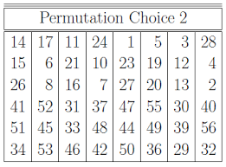
e. Concatenate Cn and Dn
C1 || D1 = 0000000111111110000000000100 0001100010000011101001001000
C2 || D2 = 0000001111111100000000001000 0011000100000111010010010000
f. PC-2 (Permuted Choice 2) takes the 56 bits (Cn‖Dn) and selects 48 bits out of them, discarding 8 bits.
positions 9, 18, 22, 25, 35, 38, 43, 54 are removed then permuted using PC-2 table
C1 || D1 = 0000000111111110000000000100 0001100010000011101001001000
K1 = 101000001001001011000010000110000110100001001001
now 48-bits round one key is generated Same step for all round
pc-2

Slide 7
16 ROUNDS GENERATED KEY
round | key(48 bits)
1 | 101000001001001011000010000110000110100001001001
2 | 101000000001001001010010011000000000110000110101
3 | 001001000101101001010000100010110000100010011010
4 | 000001100111000101010000000001010101001100010001
5 | 000011100100010101010001000100110000000001100100
6 | 010011110100000100001001110000001000100110000100
7 | 000010111000000110001001000000000010011010011101
8 | 000110010000100010001011011110110001000010000001
9 | 000110010000101010001000001010101010001000100110
10 | 000100000011100010001100001101000100110110000010
11 | 000100000010110001000100000011000000000001010011
12 | 010000000110110000100100110001111110000001000000
13 | 110000001010010100100100001000001000011101001000
14 | 110000001000011000100011100110001001010000000110
15 | 111000011001001000100010010011000100011010100000
16 | 101000001001001000101010000000001111100010100000

Slide 8
            Data Encryption
        Initial permutation
example
plaintext : SUCCESS
Key: DISCIPLINE we do not need key in IP we use it later in 16 rounds
step 1 : DES works only on 64 bits (8 bytes at a time ).
Each English letter = 1 byte = 8 bits.
So:
“S U C C E S S” → 7 letters → 7 × 8 = 56 bits
But DES needs 64 bits — exactly 8 characters.
So we pad with one extra space (or 0 bits):
We’ll use:
Plaintext = "SUCCESS " (with a space at the end)
plaintext(Hex) = 5355434345535320

Slide 9
step 2: Convert letters to binary (ASCII).
Character | ASCII(dec) | ASCII (hex) | Binary(bits)
S | 83 | 53 | 01010011
U | 85 | 55 | 01010101
C | 67 | 43 | 01000011
C | 67 | 43 | 01000011
E | 69 | 45 | 01000101
S | 83 | 53 | 01010011
S | 83 | 53 | 01010011
(space) | 32 | 20 | 00100000
step 3: Perform the permutation
plaintext in bits : 01010011 01010101 01000011 01000011 01000101 01010011 01010011 00100000
after IP : 01111111 01100011 00010010 01111111 00000000 10000000 00000000 01101101

Slide 10
step 4: devide this bits into two parts left and right
left L: 01111111 01100011 00010010 01111111
right R: 00000000 10000000 00000000 01101101
2. A process in Each of 16 rounds
Round-1
Inputs to Round 1 (from IP output)
left L0: 01111111 01100011 00010010 01111111
right R0: 00000000 10000000 00000000 01101101
L1 = R0
R1 = L0 XOR f(R0 XOR K1)
L1 = 00000000 10000000 00000000 01101101
-To get newRight first we have to do f- function which means Right XOR Key.
- key is 48-bits binary number and the Right bit is 32-bits binary number .
-so we have to Expand the right part first to 48 bits

Slide 11
a. Expansion
Expand the 32 bits of Right(R) part to 48 bits
INPUT right R0: 00000000 10000000 00000000 01101101
1 | 0 | 0 | 0 | 0 | 0
0 | 0 | 0 | 0 | 0 | 1
0 | 1 | 0 | 0 | 0 | 0
0 | 0 | 0 | 0 | 0 | 0
0 | 0 | 0 | 0 | 0 | 0
0 | 0 | 0 | 0 | 0 | 0
0 | 0 | 1 | 1 | 0 | 1
0 | 1 | 1 | 0 | 1 | 0
after expansion E(R₀) = 100000000001010000000000000000000000001101011010

Slide 12
b. 48 bits of E(R1) XOR with round(0) generated key (called f function)
K₁ : 101000001001001011000010000110000110100001001001
E(R₀) : 100000000001010000000000000000000000001101011010
E(R₀)⊕K₁ = 001000001000011011000010000110000110101100010011
c. Substitution(S-Box)
The output produced by the previous step is broken into eight six-bit words.
001000 001000 011011 000010 000110 000110 101100 010011
S1
S2
S3
S4
S5
S6
S7
S8
0010 0110 1011 1101 0001 1111 0111 0101
we get 32 bit after s-box : 0010 0110 1011 1101 0001 1111 0111 0101
what is actually performed in S-Box ?

Slide 13
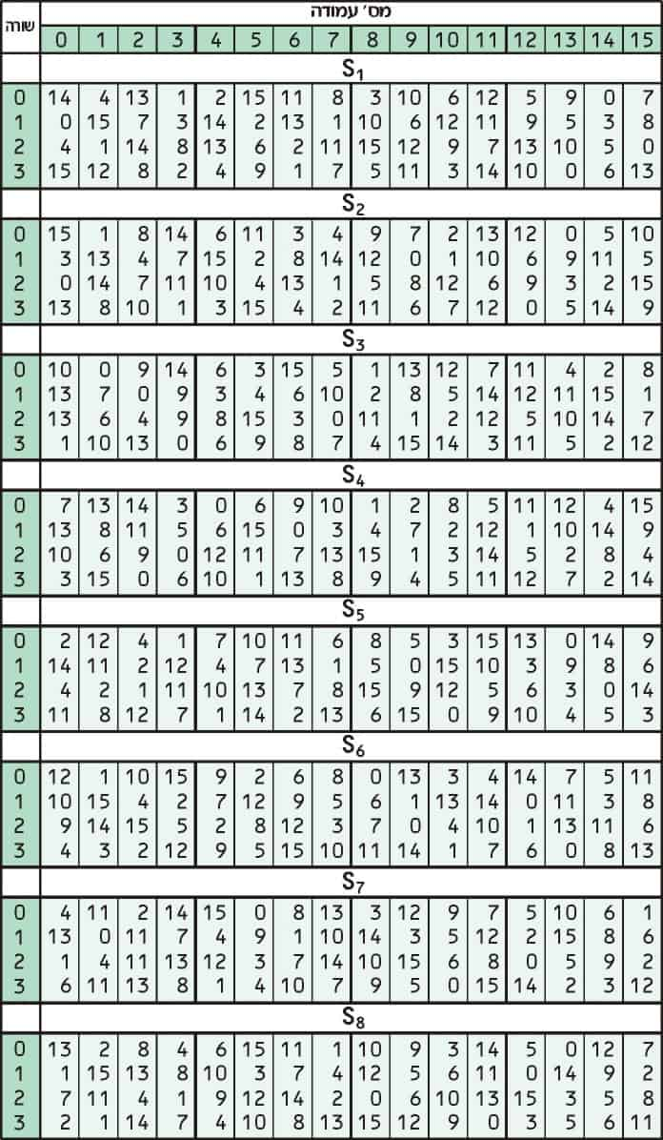
For each 6-bit block b1 b2 b3 b4 b5 b6:
Row = binary b1 b6 (2 bits → 0–3)
Column = binary b2 b3 b4 b5 (4 bits → 0–15)
Look up S_box[i][row][column] → decimal 0–15 → convert to 4-bit binary.
lets work on above S1-box
6 bit given : 001000
001000
Row : 00 binary which in decimal = 0
Column : 0100 binary which in decimal = 4
row: 0 column: 4 in the s1-table = 2
2 in binary number = 0010

Slide 14
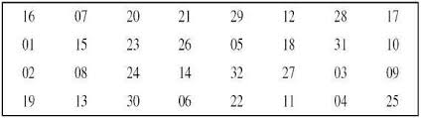
d. permutation (P-Box)
out put from S-box = 0010 0110 1011 1101 0001 1111 0111 0101
P-box output = 11110110 00110000 00111111 01111100
use this table to permutate
e. P-Box output XOR with the left half
left L0 : 01111111 01100011 00010010 01111111
P-box output = 11110110 00110000 00111111 01111100
R1= left L0 XOR P-box output
01111111 ⊕ 11110110 = 10001001
01100011 ⊕ 00110000 = 01010011
00010010 ⊕ 00111111 = 00101101
01111111 ⊕ 01111100 = 00000011
R1 = 10001001 01010011 00101101 00000011
So the result of Round-1: L1 = 00000000 10000000 00000000 01101101 R1 = 10001001 01010011 00101101 00000011

Slide 15
Round-2
L2 = R1
R2 = L1 XOR f(R1 XOR K2)
L1 = 00000000 10000000 00000000 01101101
R1 = 10001001 01010011 00101101 00000011
K2 = 101000000001001001010010011000000000110000110101
So
L2 = 10001001 01010011 00101101 00000011
f(R1 XOR K2) = 01010101 11110000 00110011 11001100
R2 = 01010101 01110000 00110011 10100001
Round-3
L3 = R2
R3 = L2 XOR f(R2 XOR K3)
L3 = 01010101 01110000 00110011 10100001
R3 = 10110101 10011111 10000111 01010110

Slide 16
Round | Left-(32)bits | Right-(32)bits
1 | 00000000 10000000 00000000 01101101 | 10001001 01010011 00101101 00000011
2 | 10001001 01010011 00101101 00000011 | 01010101 01110000 00110011 10100001
3 | 01010101 01110000 00110011 10100001 | 10110101 10011111 10000111 01010110
4 | 10110101 10011111 10000111 01010110 | 10100101 01111111 10110111 10101110
5 | 10100101 01111111 10110111 10101110 | 10111010 01101111 10001000 11100110
6 | 10111010 01101111 10001000 11100110 | 00001111 11010101 11100010 11111011
7 | 00001111 11010101 11100010 11111011 | 01011001 10100000 01001000 00010001
8 | 01011001 10100000 01001000 00010001 | 11110110 11010101 10111111 00010011
9 | 11110110 11010101 10111111 00010011 | 01011001 01110101 01001000 11101110
10 | 01011001 01110101 01001000 11101110 | 11101100 10000000 00000001 01000101
11 | 11101100 10000000 00000001 01000101 | 10001101 00110101 01010101 00010000
12 | 10001101 00110101 01010101 00010000 | 01111100 10110101 11110001 01000101
13 | 01111100 10110101 11110001 01000101 | 10000001 10111010 01010010 01010110
14 | 10000001 10111010 01010010 01010110 | 10011111 01001010 11110001 01000101
15 | 10011111 01001010 11110001 01000101 | 10000001 10111010 10101111 10101011
16 | 10000001 10111010 10101111 10101011 | 00111110 11110000 10100100 00010000

Slide 17
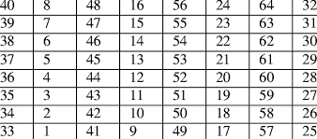
L16 : 10000001 10111010 10101111 10101011
R16 : 00111110 11110000 10100100 00010000
3. 32-bits Swap
preoutput Concatenate(L16 || R16)
Before Swap (L16 || R16) : 10000001 10111010 10101111 10101011 00111110 11110000 10100100 00010000
After Swap(R16 || L16) : 00111110 11110000 10100100 00010000 10000001 10111010 10101111 10101011
3. Inverse Initial Permutation
(R16 || L16) : 00111110 11110000 10100100 00010000 10000001 10111010 10101111 10101011
Inverse Initial permutation table
Inv IP : 10001010 01101010 01001100 01101010 01110001 01111110 00010000 10111110

Slide 18
Inverted Initial permutaion binary number is called Ciphertext(binary)
Ciphertext(binary) : 10001010 01101010 01001100 01101010 0110001 01111110 00010000 10111110
Ciphertext(hex): 8A6A4C6A717E10BE
plaintext Message(hex) : 5355434345535320 Encrypted with a KEY 4449534349504C49
in DES give us
Ciphertext(hex): 8A6A4C6A717E10BE

Slide 19
THANK YOU

